Slide 1
Oscilloscope and Power Supply Tutorial
EE 213B Module 3 Rahul Iyer

Slide 2
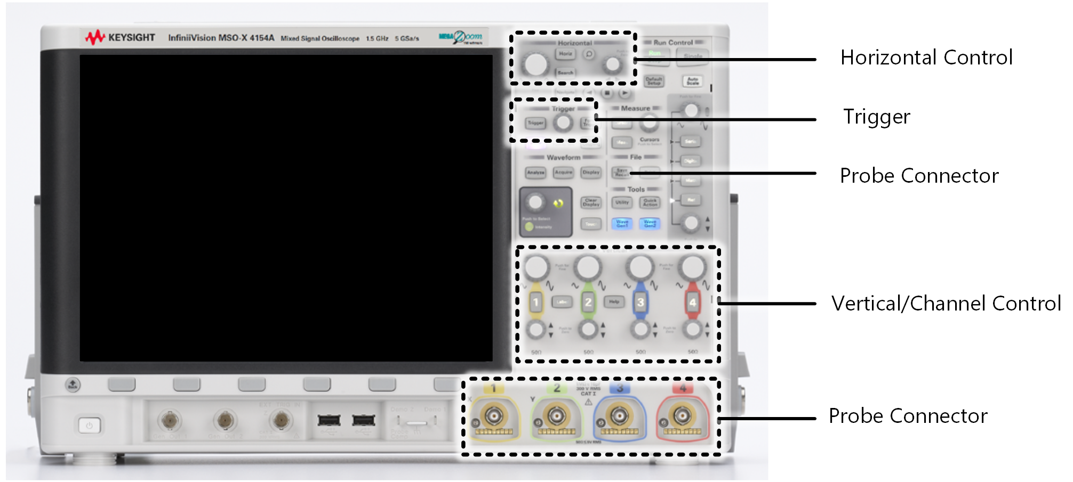
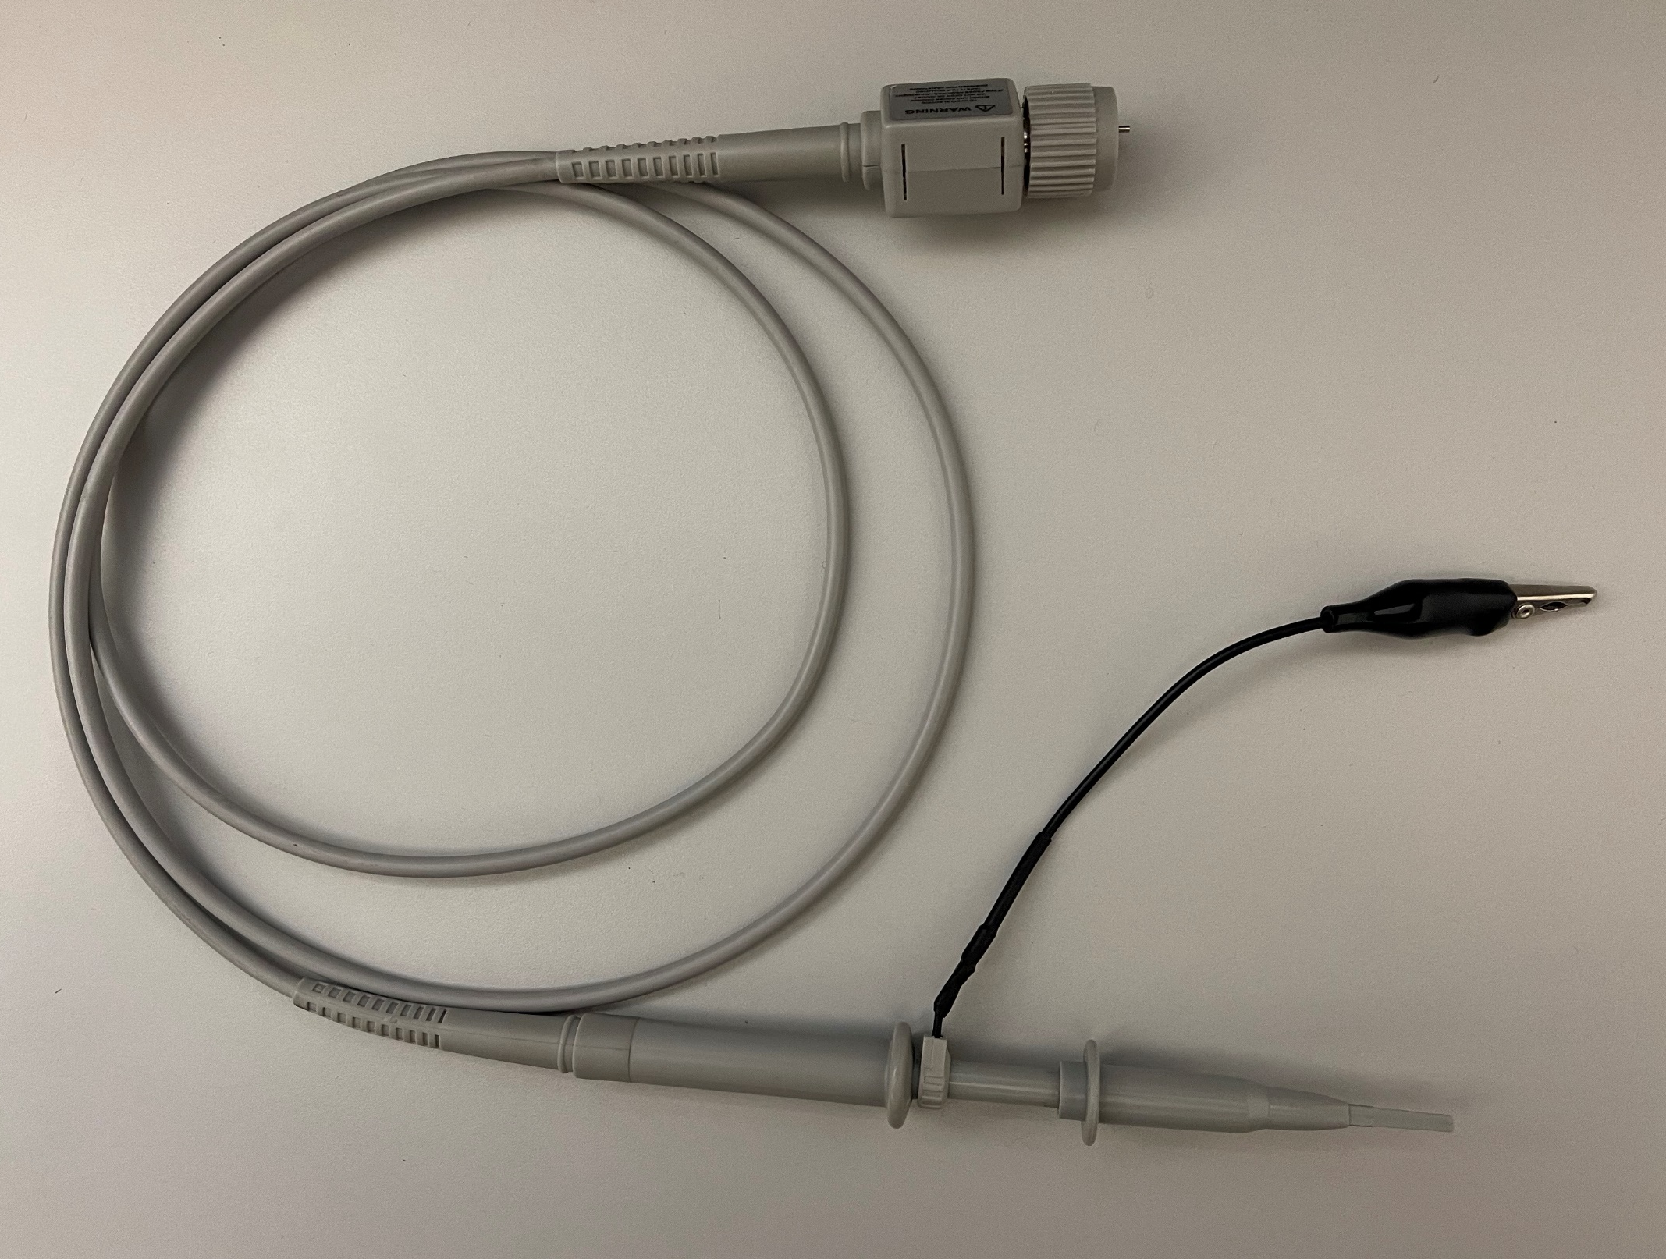
Oscilloscope Overview
Oscilloscope
Oscilloscope Probe

Slide 3
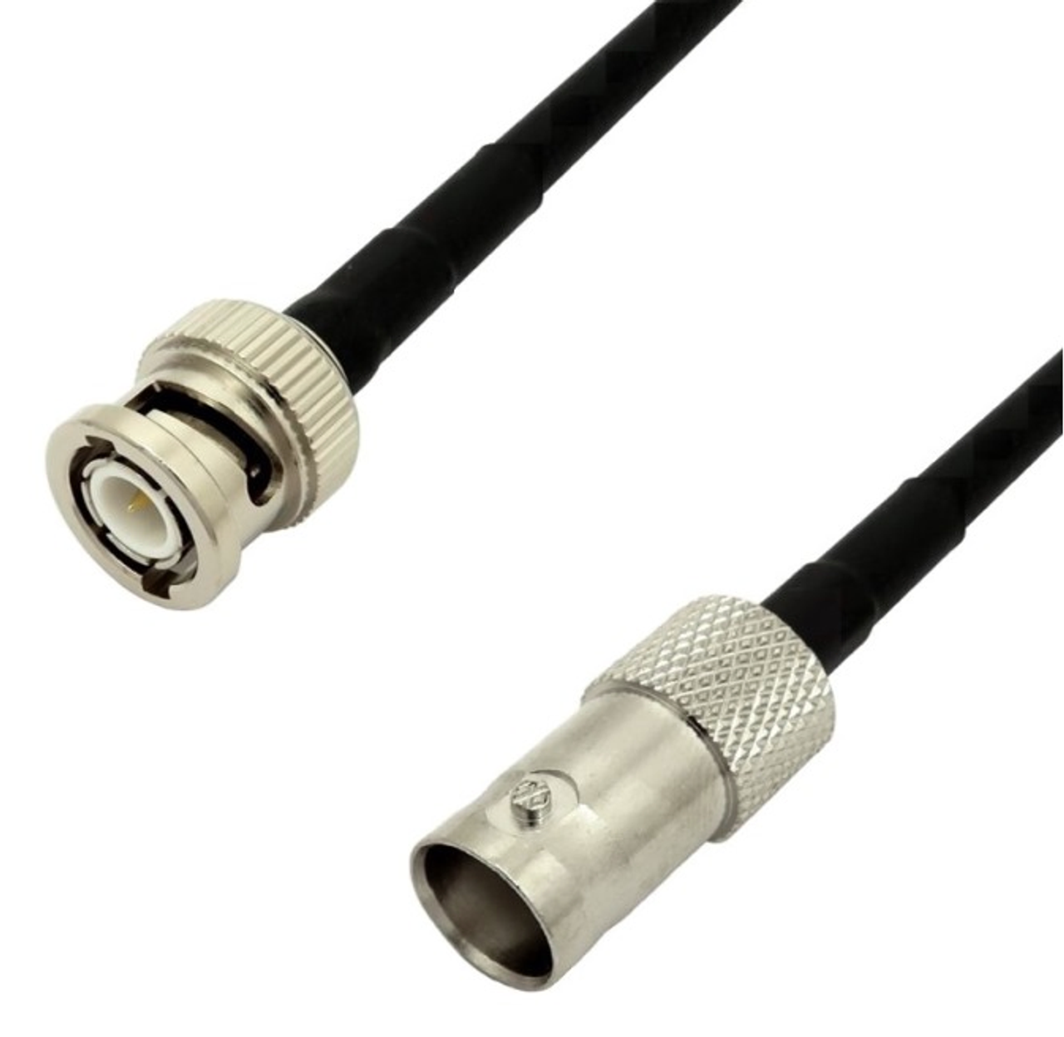
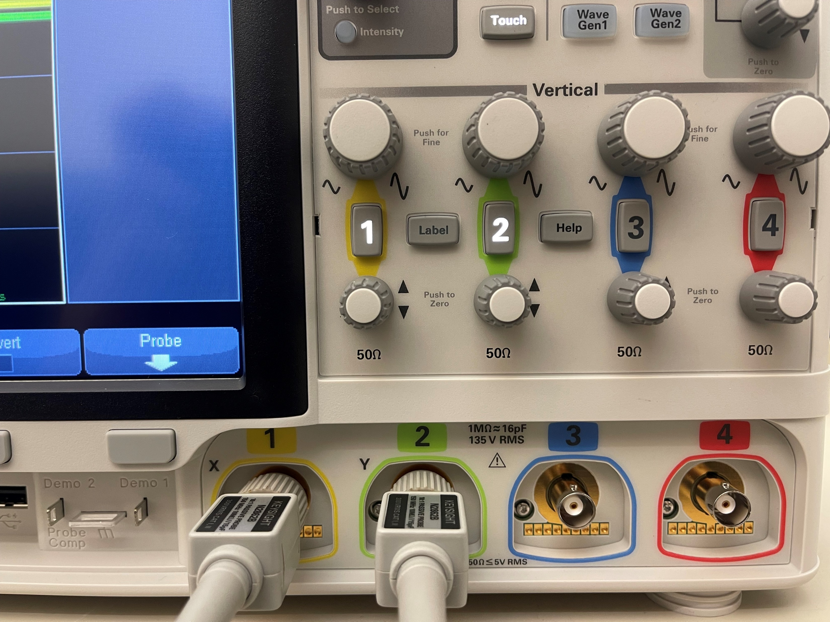
Connect the Probes to Channel 1 and 2
Align the pin and keyway, then push the connectors together.
Turn the connectors clockwise by 90 degrees to lock
Locking keyway
Locking pin

Slide 4
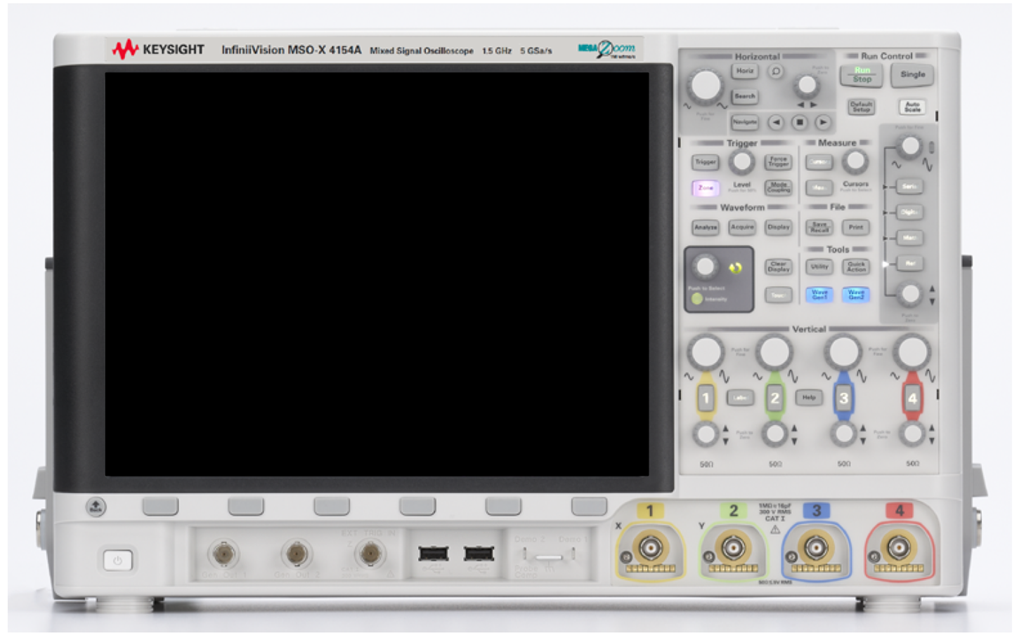
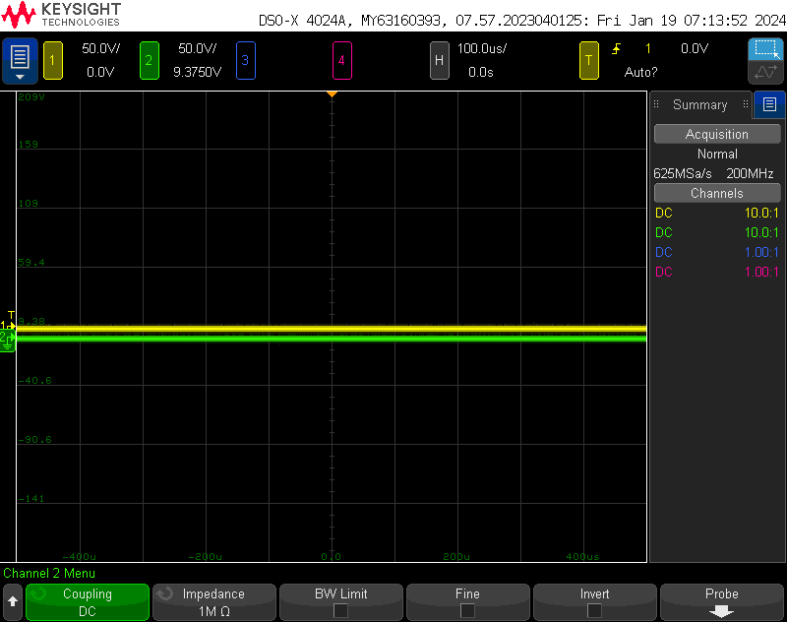
Oscilloscope after Power-On
Press these button to select/enable/disable channels

Slide 5
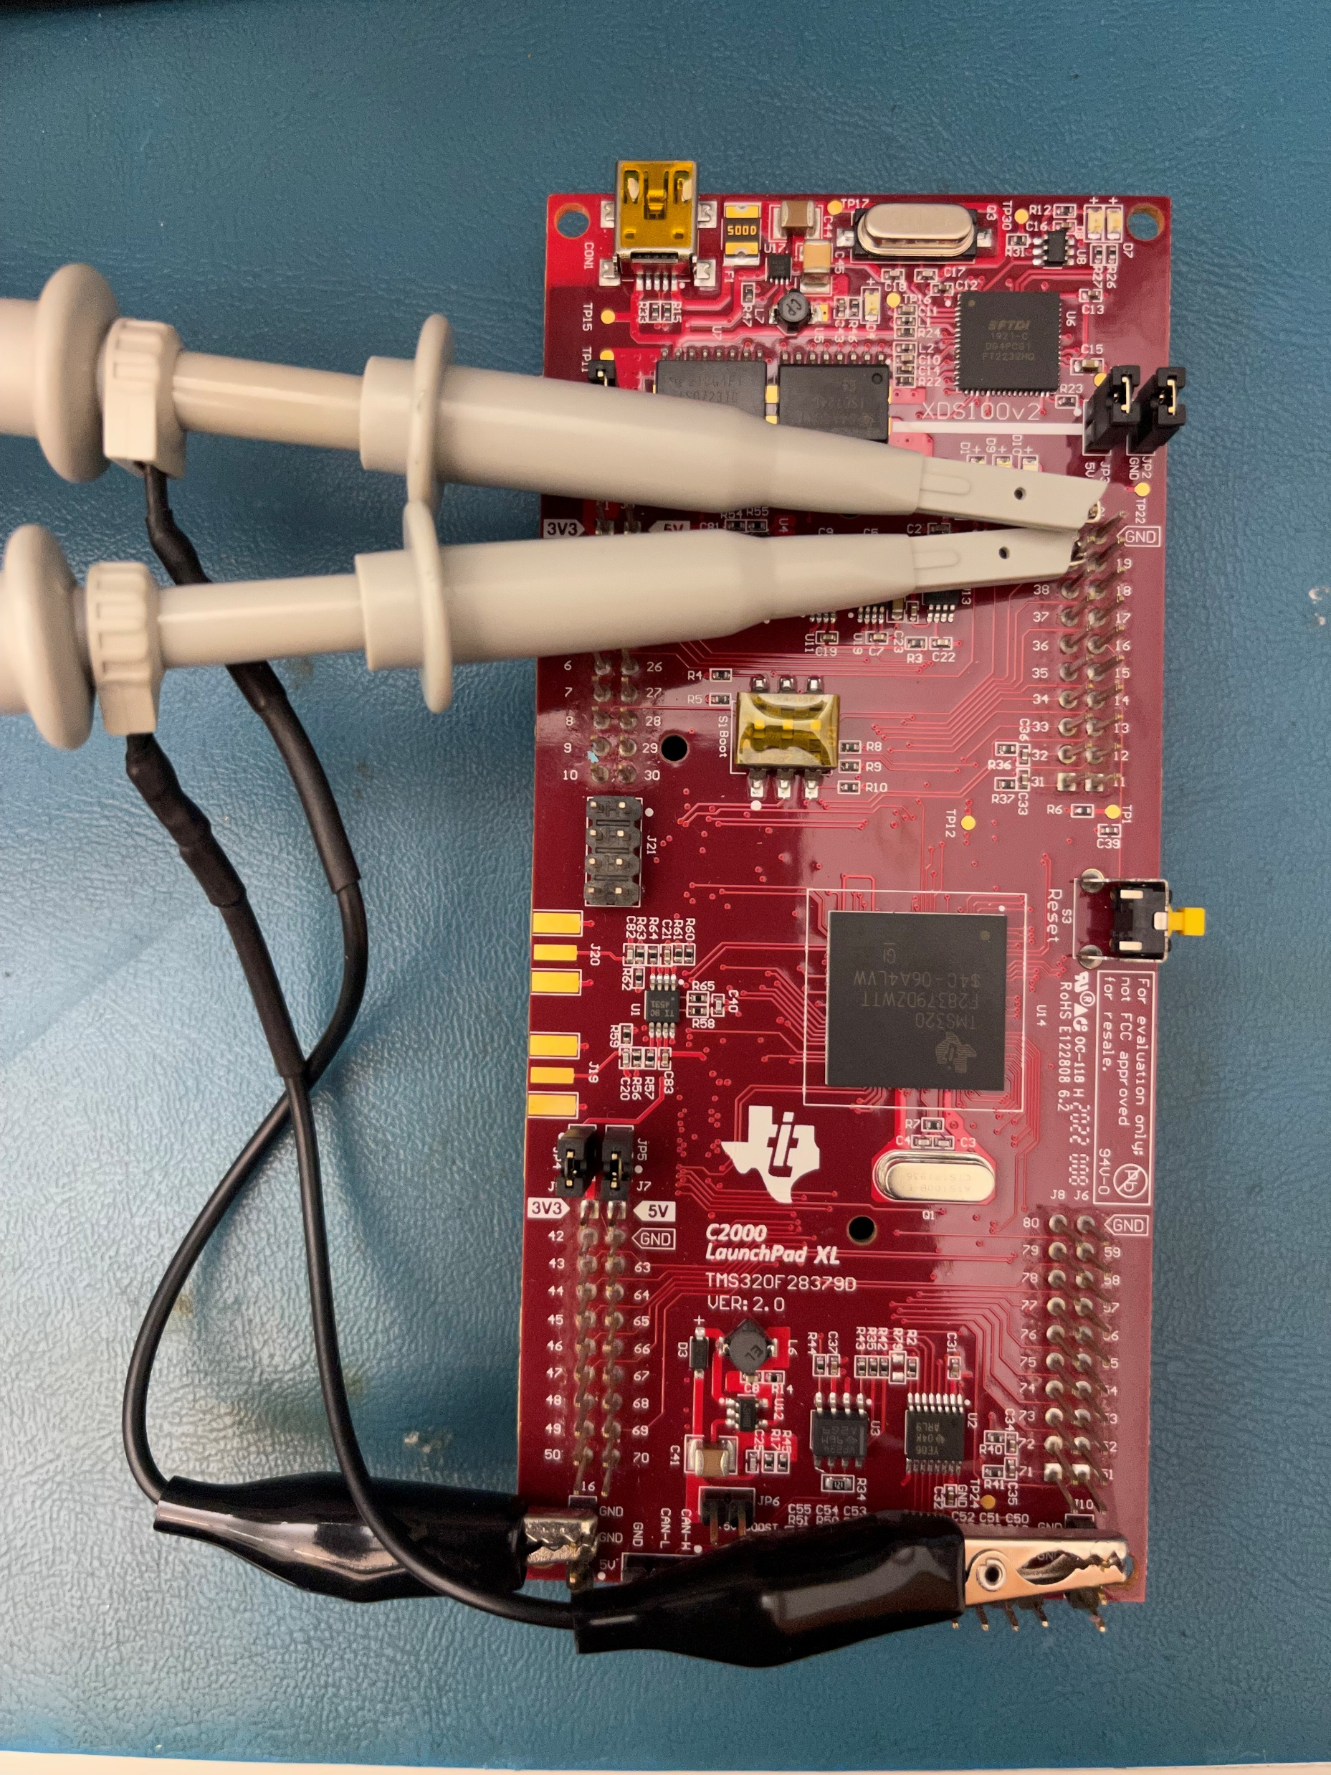
Making Connections to Hardware
Always check your connections before powering on the hardware!

Slide 6
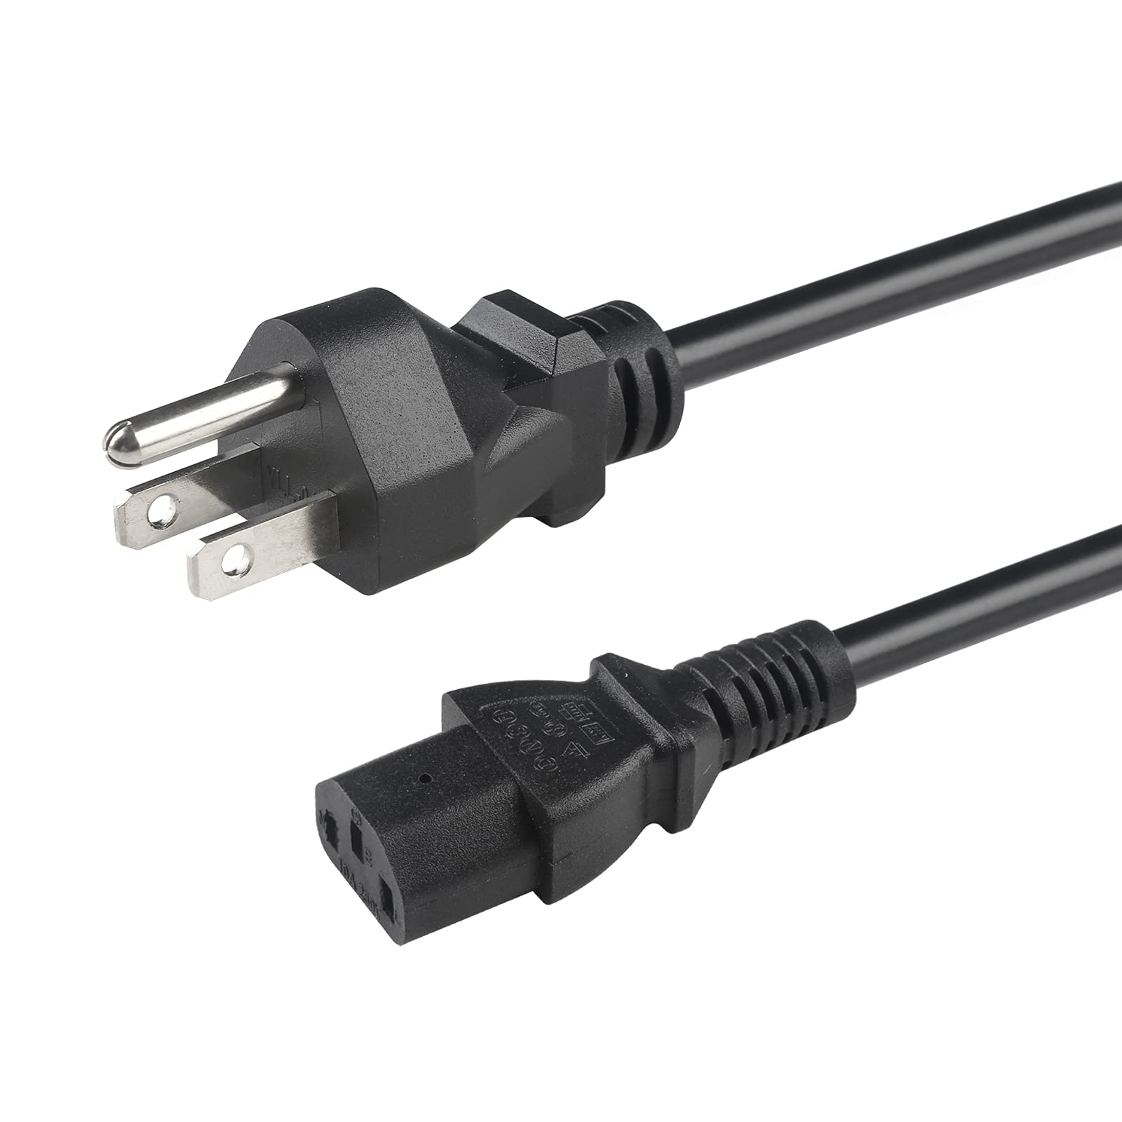
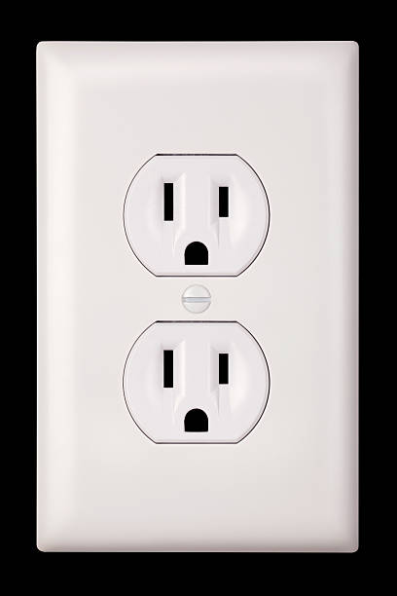
Oscilloscope Grounding!
The reference lead is connected inside the oscilloscope to Earth!
Careless reference lead connection can short parts of your circuit!

Slide 7
Oscilloscope Grounding!
CHECK YOUR PROBE CONNECTIONS WITH AN INSTRUCTOR!

Slide 8
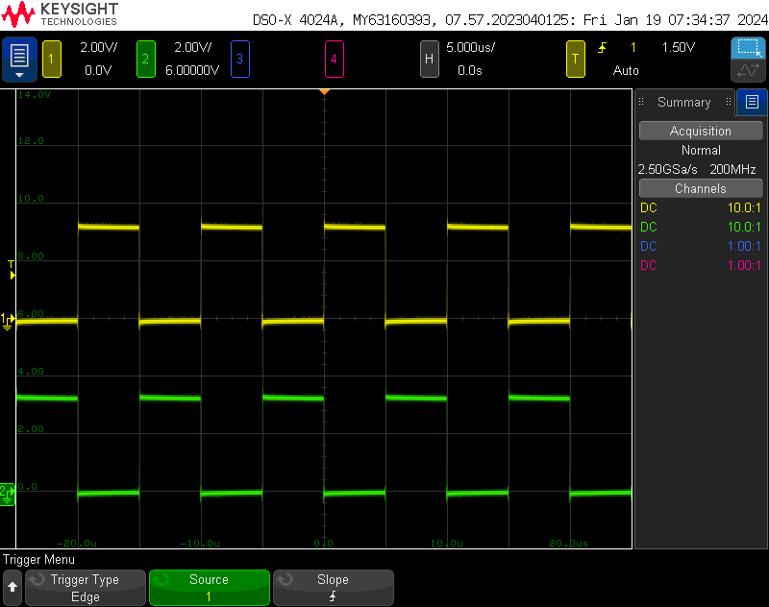
Scaling the Waveforms
Adjust the horizontal scaling (seconds/division)
Adjust the horizontal offset (relative to trigger instant)
Adjust the vertical scaling (volts/division)
Adjust the vertical offset (volts)

Slide 9
Selecting the Waveform Trigger
Open the trigger menu
Select the trigger source
Trigger Type (Rising Edge default)

Slide 10
Adjusting the Trigger Level
Trigger Level Readout
Adjust the trigger level to 1.5V
Trigger Level Cursor

Slide 11
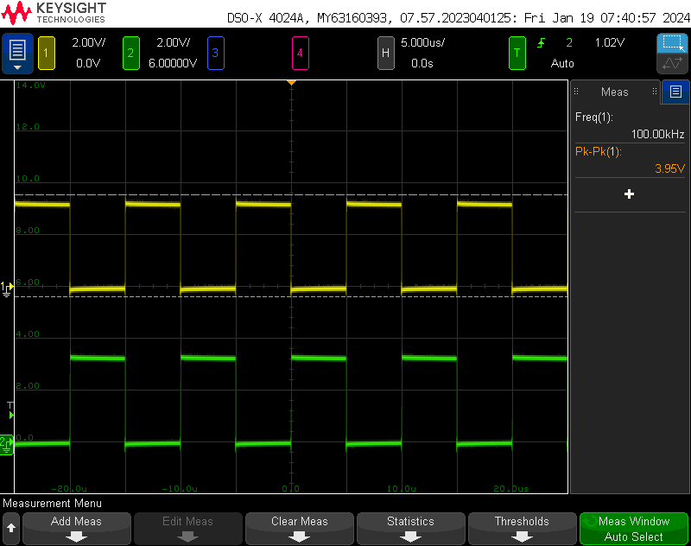
Add an automated measurement
Open the “measure” menu
Add a measurement

Slide 12
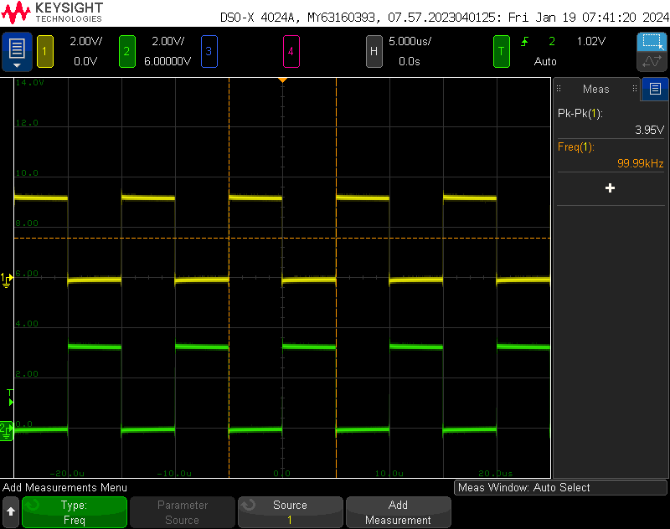
Add an automated measurement
Measurement type: frequency
Measure channel 1
Add measurement to list

Slide 13
Add an automated measurement
Frequency Readout

Slide 14
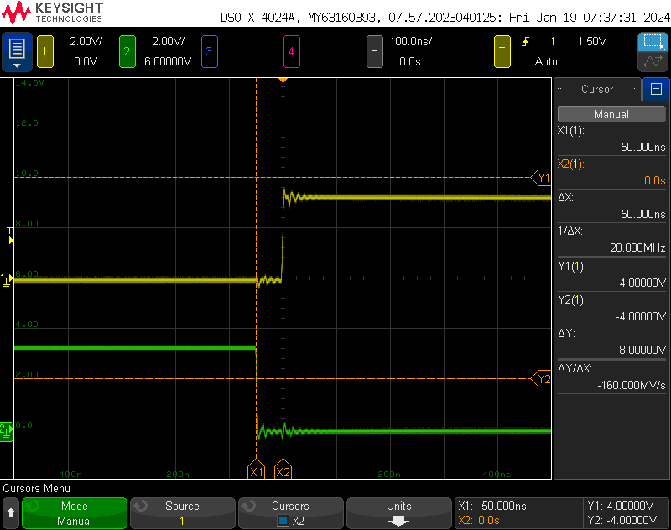
Measure deadtime using cursors
Zoom in to see the PWM waveform edges
Open the cursor menu
If measurements are turned on, you will first need to turn them off by pressing the “Meas” button

Slide 15
Measure deadtime using cursors
Select the X1 cursor by pressing this knob Scroll the knob to align the X1 cursor with the falling edge of channel 2 Select the X2 cursor by pressing the knob Scroll to align X2 with rising edge of channel 1

Slide 16
Measure deadtime using cursors
Time difference readout

Slide 17
Save oscilloscope waveforms
Open the save menu
Select file location, type, options
Connect a USB flash drive

Slide 18
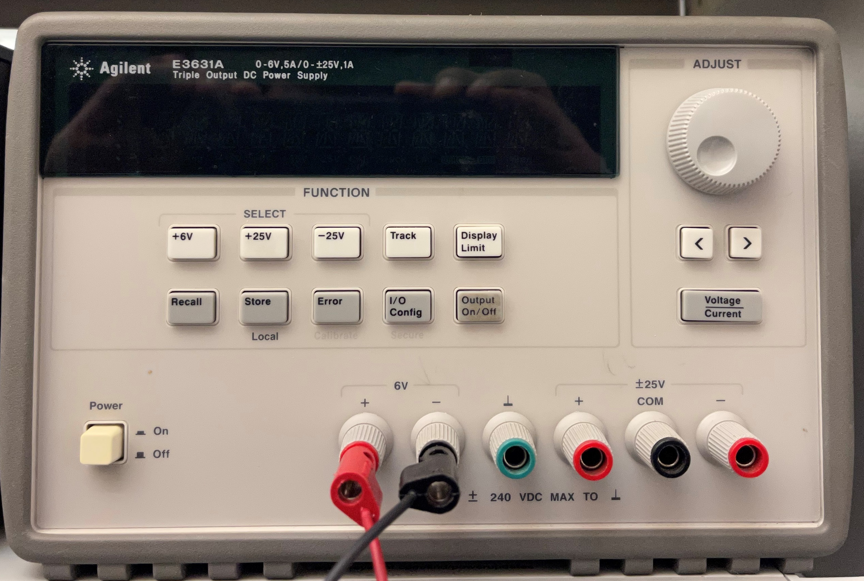
Using the Power Supply
Select 6V channel

Slide 19
Using the Power Supply
View/Hide voltage and current limits
Scroll to set value in decimal place
Change which decimal place is being adjusted
Toggle voltage/current selection

Slide 20
Using the Power Supply
Turn on channel output

Slide 21
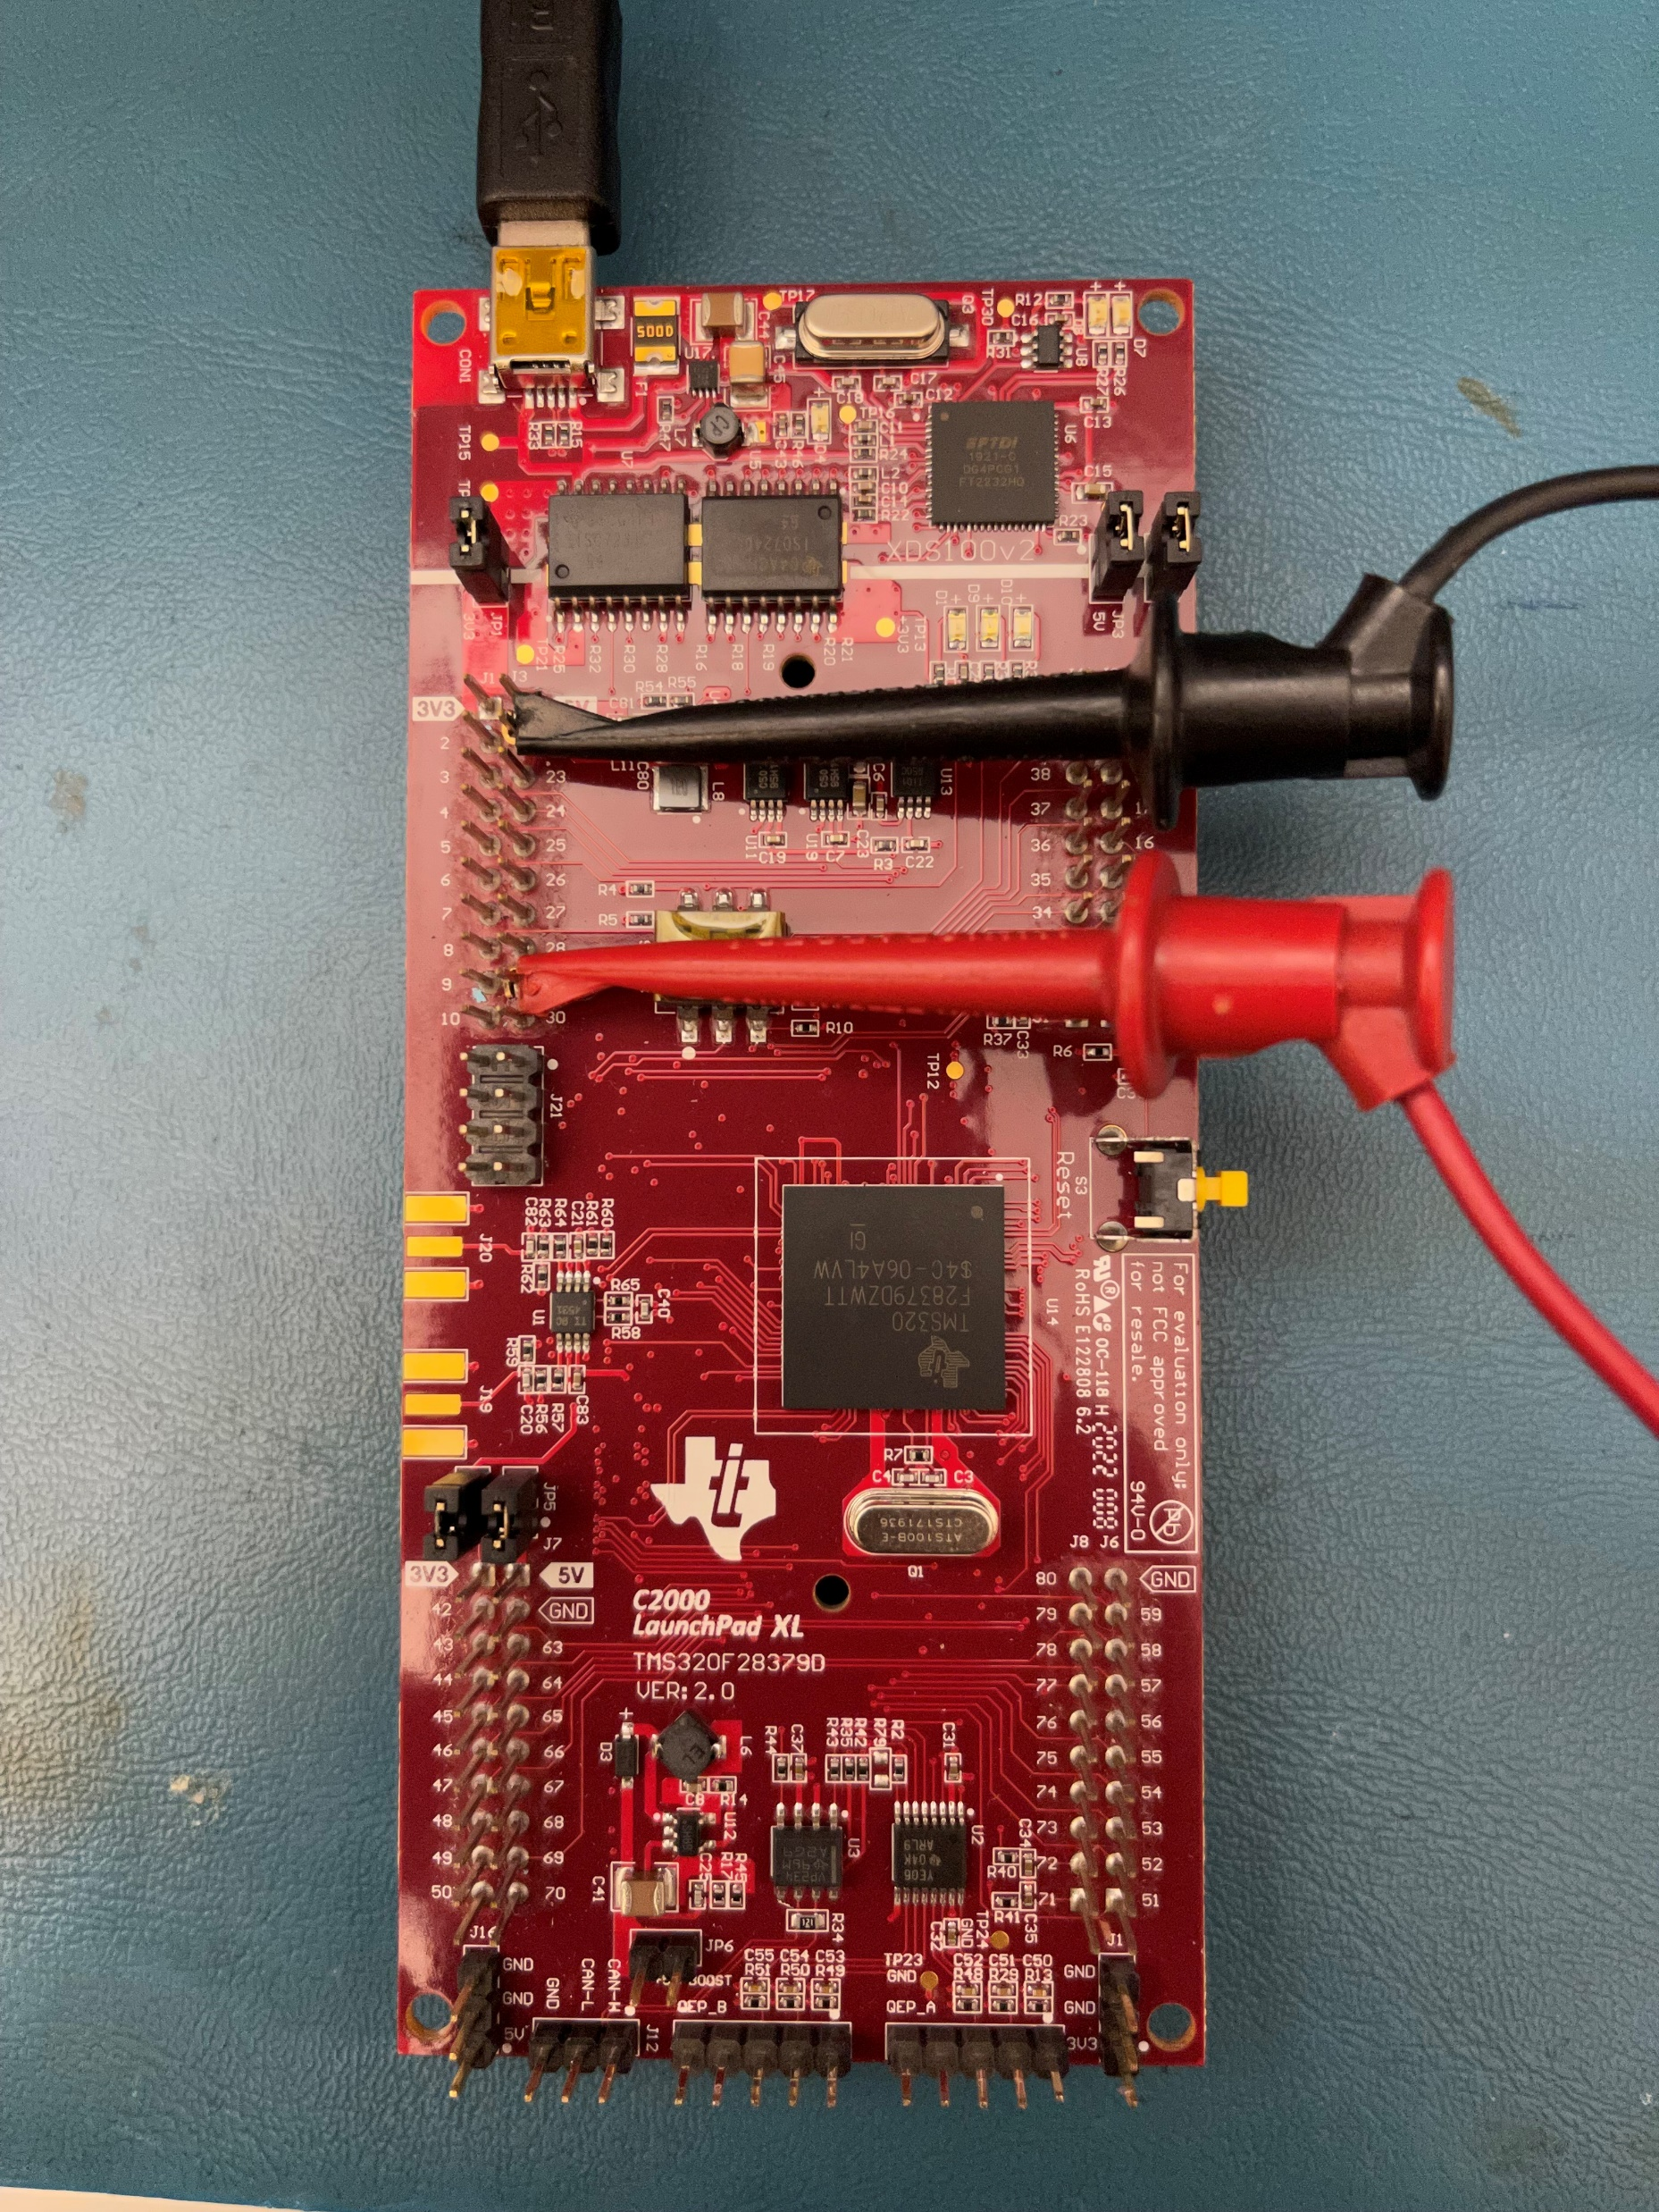

Connect the Power Supply to the ADC pin
Ensure that you are applying no more than 3V to the microcontroller pins

